Slide 1

Warby Parker Capstone
Learn SQL from Scratch
Pete Lang
7/16/2018

Slide 2
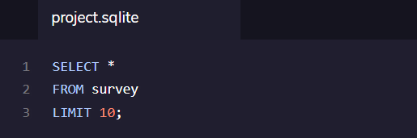
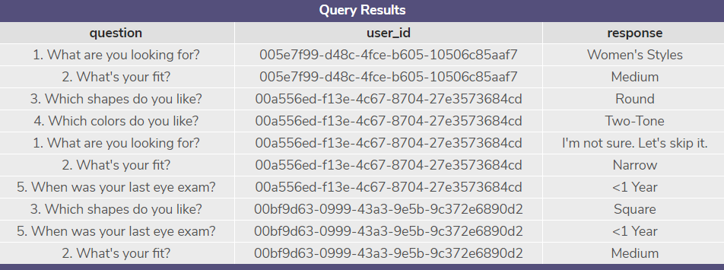
1. Exploring the Survey Table
Using the criteria below, I found the following columns.
question
user_id
response

Slide 3
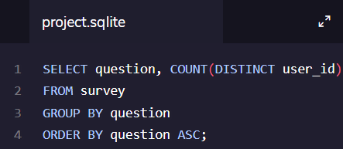
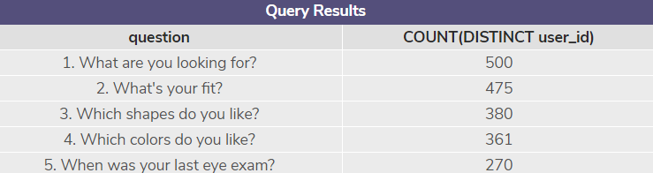
2. Survey Question Results
Warby Parker is experiencing some survey fatigue. They see a dramatic drop of 54% from the 1st question to the last.
500
475
380
361
270

Slide 4
3. Survey Question Analysis
Out of the 500 survey takers, we saw two large dips in responses around the shape and eye exam questions.
I imagine that the drop from Q2 to Q3 of 20% can be explained by looking at the question. Users reached this question and may have went to the website to begin looking at the variety of shape options or they want to include multiple results.
The drop from Q4 to Q5 of 25.2% can be explained by the survey takers may not understand why the company would ask health information in a quiz about the perfect frame. The other questions relate to style and fit while last eye exam would not make an impact on those results.
Number | Question | Response Count | Completion Rate (all quiz takers) | Question to Question Drop Rate
1 | What are you looking for? | 500 | 100.0% | N/A
2 | What's your fit? | 475 | 95.0% | 5.0%
3 | Which shapes do you like? | 380 | 76.0% | 20.0%
4 | Which colors do you like? | 361 | 72.2% | 5.0%
5 | When was your last eye exam? | 270 | 54.0% | 25.2%

Slide 5
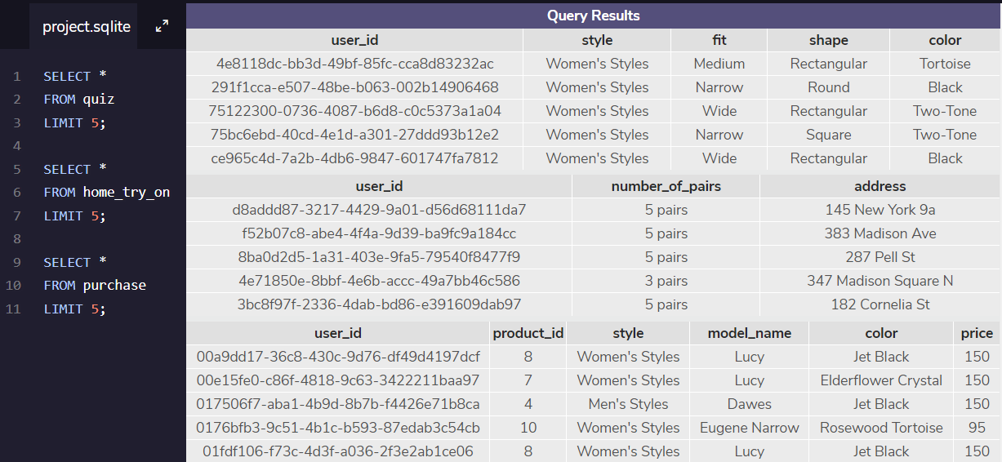
4. Funnel
In order to understand the Warby Parker funnel and its tables, I used the code to generate tables.

Slide 6
4. Funnel Table with Column Names
user_id
style
fit
shape
color
home_try_on
user_id
number_of_pairs
address
purchase
user_id
product_id
style
model_name
color
price
quiz

Slide 7
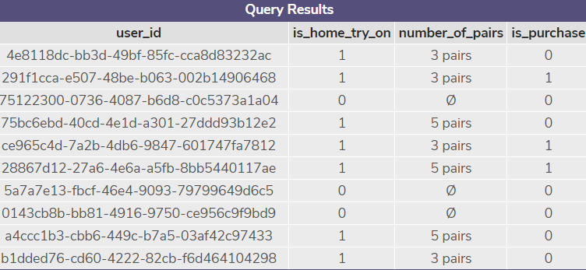
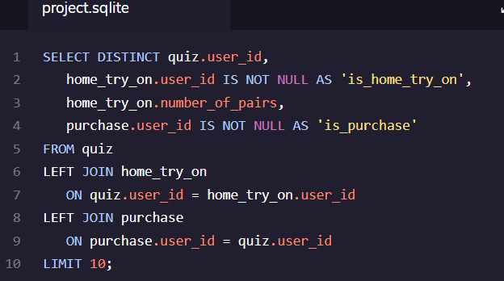
5. Combined Funnel Table
Using the Left Join, you are able to combine the different tables to include the following fields
user_id
is_home_try_on
number_of_pairs
is_purchase

Slide 8
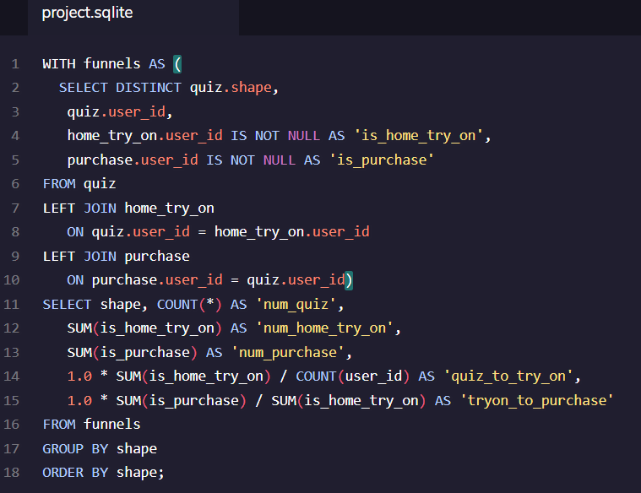
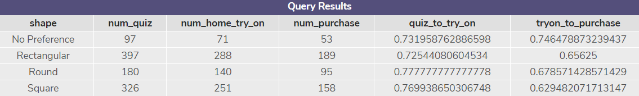
6. Funnel Insignts
The most interesting and actionable item that I found is that those who had no preference when shape is concerned have the highest turn from home try on to purchase. No preference just beat Rectangular to gain the home try on, but they we’re by far the highest to end in purchase. This may be because the glasses included in the box of denoted shapes are too similar where the No preference glasses would have an assortment of the other 3. I would always include a “Warby Parker pick” of a completely different shape just so the customer can see another option to compare a real difference against.

Slide 9
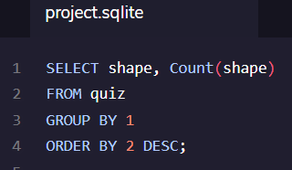
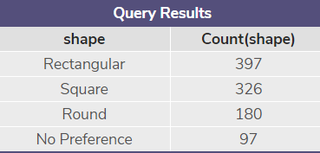
6. Funnel Insights
Using the quiz info, I was curious to see what were the most popular options were. I would promote these to the top of any marketing efforts.
Shape = Rectangle
Style = Women’s
Fit = Narrow
Color = Tortoise

